Slide 1
Instruction Set of 8086
M Siva Srinivasa Rao
Asst. Professor

Slide 2
Instruction Set of 8086
An instruction is a binary pattern designed inside a microprocessor to perform a specific function.
The entire group of instructions that a microprocessor supports is called Instruction Set.
8086 has more than 20,000 instructions.

Slide 3
Classification of Instruction Set
Data Transfer Instructions
Arithmetic Instructions
Bit Manipulation Instructions/Logical instructions
Program Execution Transfer Instructions
String Instructions
Processor Control Instructions

Slide 4
Data Transfer Instructions
These instructions are used to transfer data from source to destination.
The operand can be a constant, memory location, register or I/O port address.

Slide 5
Data Transfer Instructions
MOV Des, Src:
Src operand can be register, memory location or immediate operand.
Des can be register or memory operand.
Both Src and Des cannot be memory location at the same time.
Incase of immediate addressing mode ,A Segment register cont be a destination register.
E.g.:
MOV CX, 037A H
MOV AL, BL
MOV BX, [0301 H]

Slide 6
Data Transfer Instructions
PUSH Operand:
It pushes the operand into top of stack.
E.g.: PUSH BX
POP Des:
It pops the operand from top of stack to Des.
Des can be a general purpose register, segment register (except CS) or memory location.
E.g.: POP AX

Slide 7
Data Transfer Instructions
XCHG Des, Src:
This instruction exchanges Src with Des.
It cannot exchange two memory locations directly.
E.g.: XCHG DX, AX
XLAT
MOV AL,03H
MOV BX,[2000H]
XLAT

Slide 8
Data Transfer Instructions
IN Accumulator, Port Address:
It transfers the operand from specified port to accumulator register.
E.g.: IN AX, 0028 H
OUT Port Address, Accumulator:
It transfers the operand from accumulator to specified port.
E.g.: OUT 0028 H, AX

Slide 9
Data Transfer Instructions
LEA Register, Src:
It loads a 16-bit register with the offset address of the data specified by the Src.
E.g.: LEA BX, [DI]
This instruction loads the contents of DI (offset) into the BX register.
LEA ax, [BP+SI+5] ; Compute address of value
MOV ax, [BP+SI+5] ; Load value at that address

Slide 10
Data Transfer Instructions
LDS Des, Src:
It loads 32-bit pointer from memory source to destination register and DS.
The offset is placed in the destination register and the segment is placed in DS.
To use this instruction the word at the lower memory address must contain the offset and the word at the higher address must contain the segment.
E.g.: LDS BX, [0301 H]

Slide 11
Data Transfer Instructions
LES Des, Src:
It loads 32-bit pointer from memory source to destination register and ES.
The offset is placed in the destination register and the segment is placed in ES.
This instruction is very similar to LDS except that it initializes ES instead of DS.
E.g.: LES BX, [0301 H]

Slide 12
Data Transfer Instructions
LAHF:
It copies the lower byte of flag register to AH.
SAHF:
It copies the contents of AH to lower byte of flag register.
PUSHF:
Pushes flag register to top of stack.
POPF:
Pops the stack top to flag register.

Slide 13
Arithmetic Instructions
ADD Des, Src:
It adds a byte to byte or a word to word.
It effects AF, CF, OF, PF, SF, ZF flags.
E.g.:ADD AL, 74H
ADD DX, AX
ADD AX, [BX]
ADD AX, [1000H]
ADD [1000H],2000H
ADD 1000H- Destination is AX

Slide 14
Arithmetic Instructions
ADC Des, Src:
It adds the two operands with CF.
It effects AF, CF, OF, PF, SF, ZF flags.
E.g.:ADC AL, 74H
ADC DX, AX
ADC AX, [BX]
ADC AX, [1000H]
ADC [1000H],2000H
ADC 1000H- Destination is AX

Slide 15
Arithmetic Instructions
SUB Des, Src:
It subtracts a byte from byte or a word from word.
It effects AF, CF, OF, PF, SF, ZF flags.
For subtraction, CF acts as borrow flag.
E.g.:
SUB AL, 74H
SUB DX, AX
SUB AX, [BX]

Slide 16
Arithmetic Instructions
SBB Des, Src:
It subtracts the two operands and also the borrow from the result.
It effects AF, CF, OF, PF, SF, ZF flags.
E.g.:
SBB AL, 74H
SBB DX, AX
SBB AX, [BX]

Slide 17
Arithmetic Instructions
INC Src:
It increments the byte or word by one.
The operand can be a register or memory location.
It effects AF, OF, PF, SF, ZF flags.
CF is not effected.
E.g.: INC AX

Slide 18
Arithmetic Instructions
DEC Src:
It decrements the byte or word by one.
The operand can be a register or memory location.
It effects AF, OF, PF, SF, ZF flags.
CF is not effected.
E.g.: DEC AX

Slide 19
Arithmetic Instructions
AAA (ASCII Adjust after Addition):
The data entered from the terminal is in ASCII format.
In ASCII, 0 – 9 are represented by 30H – 39H.
This instruction allows us to add the ASCII codes.
This instruction does not have any operand.
Other ASCII Instructions:
AAS (ASCII Adjust after Subtraction)
AAM (ASCII Adjust after Multiplication)
AAD (ASCII Adjust Before Division)

Slide 20
AAS
MOV AX,0901H ; BCD 91
SUB AL, 9 ; Minus 9
AAS ; Give AX =0802 h (BCD 82)

Slide 21
AAD
Example: ;AX=0607 unpacked BCD for 67 decimal ;CH=09H
AAD ;Adjust to binary before division ;AX=0043 = 43H =67 decimal
DIV CH ;Divide AX by unpacked BCD in CH ;
AL = quotient = 07 unpacked BCD ;
AH = remainder = 04 unpacked BCD

Slide 22
AAM
MOV AL, 5
MOV BL, 7
MUL BL ;Multiply AL by BL , result in AX
AAM ;After AAM, AX =0305h (BCD 35)

Slide 23
Arithmetic Instructions
DAA (Decimal Adjust after Addition)
It is used to make sure that the result of adding two BCD numbers is adjusted to be a correct BCD number.
It only works on AL register.
DAS (Decimal Adjust after Subtraction)
It is used to make sure that the result of subtracting two BCD numbers is adjusted to be a correct BCD number.
It only works on AL register.

Slide 24
Arithmetic Instructions
NEG Src:
It creates 2’s complement of a given number.
That means, it changes the sign of a number.

Slide 25
Arithmetic Instructions
CMP Des, Src:
It compares two specified bytes or words.
The Src and Des can be a constant, register or memory location.
Both operands cannot be a memory location at the same time.
The comparison is done simply by internally subtracting the source from destination.
The value of source and destination does not change, but the flags are modified to indicate the result.

Slide 26
Arithmetic Instructions
MUL Src:
It is an unsigned multiplication instruction.
It multiplies two bytes to produce a word or two words to produce a double word.
AX = AL * Src
DX : AX = AX * Src
This instruction assumes one of the operand in AL or AX.
Src can be a register or memory location.
IMUL Src:
It is a signed multiplication instruction.

Slide 27
Arithmetic Instructions
DIV Src:
It is an unsigned division instruction.
It divides word by byte or double word by word.
The operand is stored in AX, divisor is Src and the result is stored as:
AH = remainder AL = quotient
IDIV Src:
It is a signed division instruction.

Slide 28
Arithmetic Instructions
CBW (Convert Byte to Word):
This instruction converts byte in AL to word in AX.
The conversion is done by extending the sign bit of AL throughout AH.
CWD (Convert Word to Double Word):
This instruction converts word in AX to double word in DX : AX.
The conversion is done by extending the sign bit of AX throughout DX.

Slide 29
Bit Manipulation Instructions/Logical instructions
These instructions are used at the bit level.
These instructions can be used for:
Basic Logic Operators
Shift bits across registers

Slide 30
Bit Manipulation Instructions
NOT Src:
It complements each bit of Src to produce 1’s complement of the specified operand.
The operand can be a register or memory location.
NOT Ax
NOT [5000H]

Slide 31
Bit Manipulation Instructions
AND Des, Src:
It performs AND operation of Des and Src.
Src can be immediate number, register or memory location.
Des can be register or memory location.
Both operands cannot be memory locations at the same time.
CF and OF become zero after the operation.
PF, SF and ZF are updated.

Slide 32
Bit Manipulation Instructions
OR Des, Src:
It performs OR operation of Des and Src.
Src can be immediate number, register or memory location.
Des can be register or memory location.
Both operands cannot be memory locations at the same time.
CF and OF become zero after the operation.
PF, SF and ZF are updated.

Slide 33
Bit Manipulation Instructions
XOR Des, Src:
It performs XOR operation of Des and Src.
Src can be immediate number, register or memory location.
Des can be register or memory location.
Both operands cannot be memory locations at the same time.
CF and OF become zero after the operation.
PF, SF and ZF are updated.

Slide 34
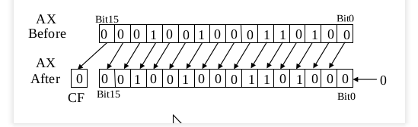
Bit Manipulation Instructions
SHL Des, Count:/SAL Des, Count:
It shift bits of byte or word left, by count.
It puts zero(s) in LSBs.
MSB is shifted into carry flag.

Slide 35
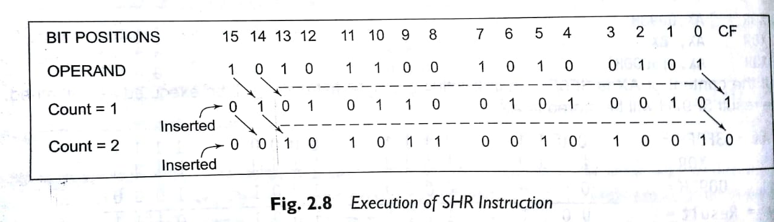
Bit Manipulation Instructions
SHR Des, Count:
It shift bits of byte or word right, by count.
It puts zero(s) in MSBs.
LSB is shifted into carry flag.

Slide 36
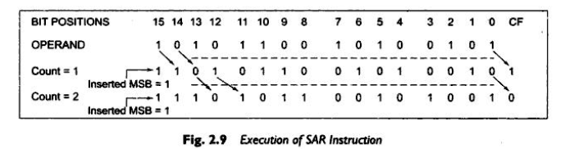
SAR Des, Count:
It shift bits of byte or word right, by count.
It puts MSB bit in MSBs position .
LSB is shifted into carry flag.

Slide 37
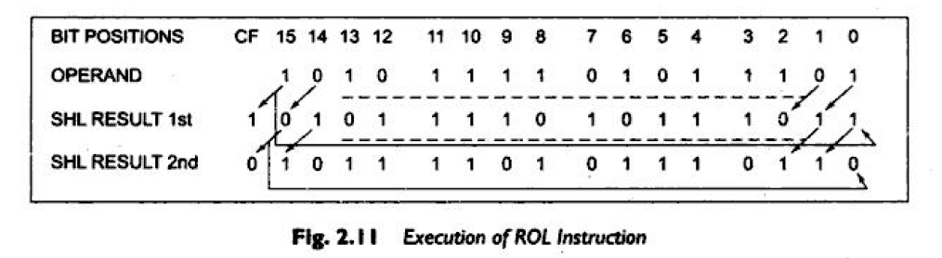
Bit Manipulation Instructions
ROL Des, Count:
It rotates bits of byte or word left, by count.
MSB is transferred to LSB and also to CF.
If the number of bits desired to be shifted is 1, then the immediate number 1 can be written in Count.
However, if the number of bits to be shifted is more than 1, then the count is put in CL register.

Slide 38
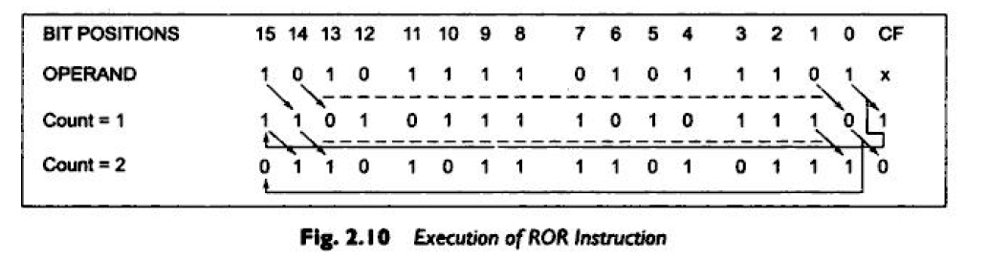
Bit Manipulation Instructions
ROR Des, Count:
It rotates bits of byte or word right, by count.
LSB is transferred to MSB and also to CF.
If the number of bits desired to be shifted is 1, then the immediate number 1 can be written in Count.
However, if the number of bits to be shifted is more than 1, then the count is put in CL register.

Slide 39
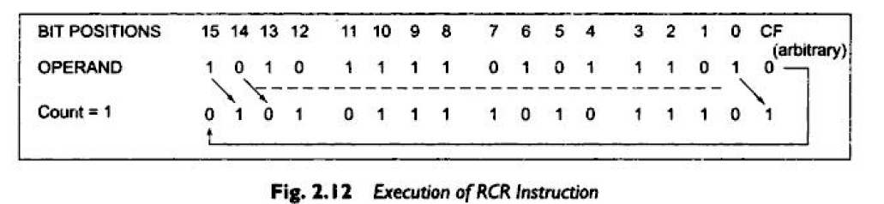
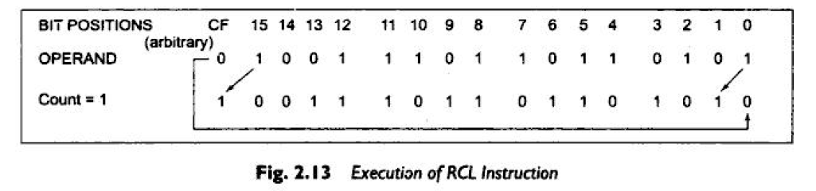
RCR
RCL

Slide 40
Program Execution Transfer Instructions/control transfer /branching instructions
Transfers the flow of execution of program to a new address specified in instruction directly or indirectly.
The conditions are represented by flags.
Unconditional control transfer instructions
Conditional control transfer instructions

Slide 41
Unconditional Branch Instructions
CALL Des:
This instruction is used to call a subroutine or function or procedure.
The address of next instruction after CALL is saved onto stack. Loads CS,IP respectively with the segment and offset address of the procedure to be called.
In case of NEAR CALL it pushes only IP ,Incase of FAR call it pushes IP and CS both onto stack.

Slide 42
RET:
It returns the control from procedure to calling program.
Every CALL instruction should have a RET.
Previously stored content of IP and CS retrieved .

Slide 43
Program Execution Transfer Instructions
JMP Des:
This instruction is used for unconditional jump from one place to another.
IRET
IRET pops the IP, CS and FLAGS from stack

Slide 44

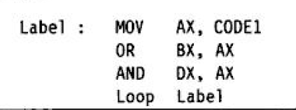
Program Execution Transfer Instructions
Loop Des:
This is a looping instruction.
The number of times looping is required is placed in the CX register.
With each iteration, the contents of CX are decremented.
ZF is checked whether to loop again or not.

Slide 45
Conditional branch instructions
Jxx Des (Conditional Jump):
All the conditional jumps follow some conditional statements or any instruction that affects the flag.

Slide 46
Conditional Jump Table
Mnemonic | Meaning | Jump Condition
JA | Jump if Above | CF = 0 and ZF = 0
JAE | Jump if Above or Equal | CF = 0
JB | Jump if Below | CF = 1
JBE | Jump if Below or Equal | CF = 1 or ZF = 1
JC | Jump if Carry | CF = 1
JE | Jump if Equal | ZF = 1
JNC | Jump if Not Carry | CF = 0
JNE | Jump if Not Equal | ZF = 0
JNZ | Jump if Not Zero | ZF = 0
JPE | Jump if Parity Even | PF = 1
JPO | Jump if Parity Odd | PF = 0
JZ | Jump if Zero | ZF = 1

Slide 47
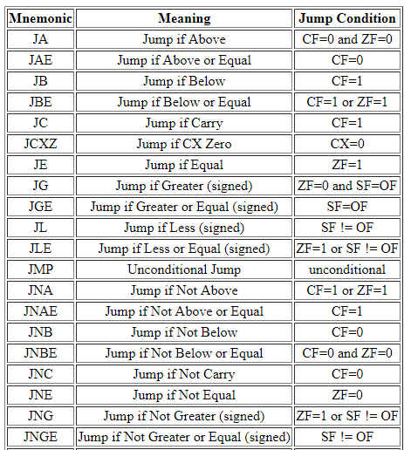

Slide 48
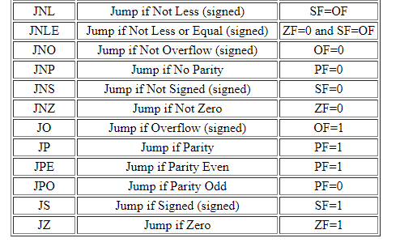

Slide 49
String Instructions
String in assembly language is just a sequentially stored bytes or words.
There are very strong set of string instructions in 8086.
By using these string instructions, the size of the program is considerably reduced.

Slide 50
String Instructions
CMPS Des, Src:
It compares the string bytes or words.
SCAS String:
It scans a string.
It compares the String with byte in AL or with word in AX.

Slide 51
String Instructions
MOVS / MOVSB / MOVSW:
It causes moving of byte or word from one string to another.
In this instruction, the source string is in Data Segment and destination string is in Extra Segment.
SI and DI store the offset values for source and destination index.

Slide 52
String Instructions
REP (Repeat):
This is an instruction prefix.
It causes the repetition of the instruction until CX becomes zero.
E.g.: REP MOVSB STR1, STR2
It copies byte by byte contents.
REP repeats the operation MOVSB until CX becomes zero.

Slide 53
Processor Control Instructions
These instructions control the processor itself.
8086 allows to control certain control flags that:
causes the processing in a certain direction
processor synchronization if more than one microprocessor attached.

Slide 54
Processor Control Instructions
STC:
It sets the carry flag to 1.
CLC:
It clears the carry flag to 0.
CMC:
It complements the carry flag.

Slide 55
Processor Control Instructions
STD:
It sets the direction flag to 1.
If it is set, string bytes are accessed from higher memory address to lower memory address.
CLD:
It clears the direction flag to 0.
If it is reset, the string bytes are accessed from lower memory address to higher memory address.

Slide 56
Thank You
Have a Nice Day

